Slide 1
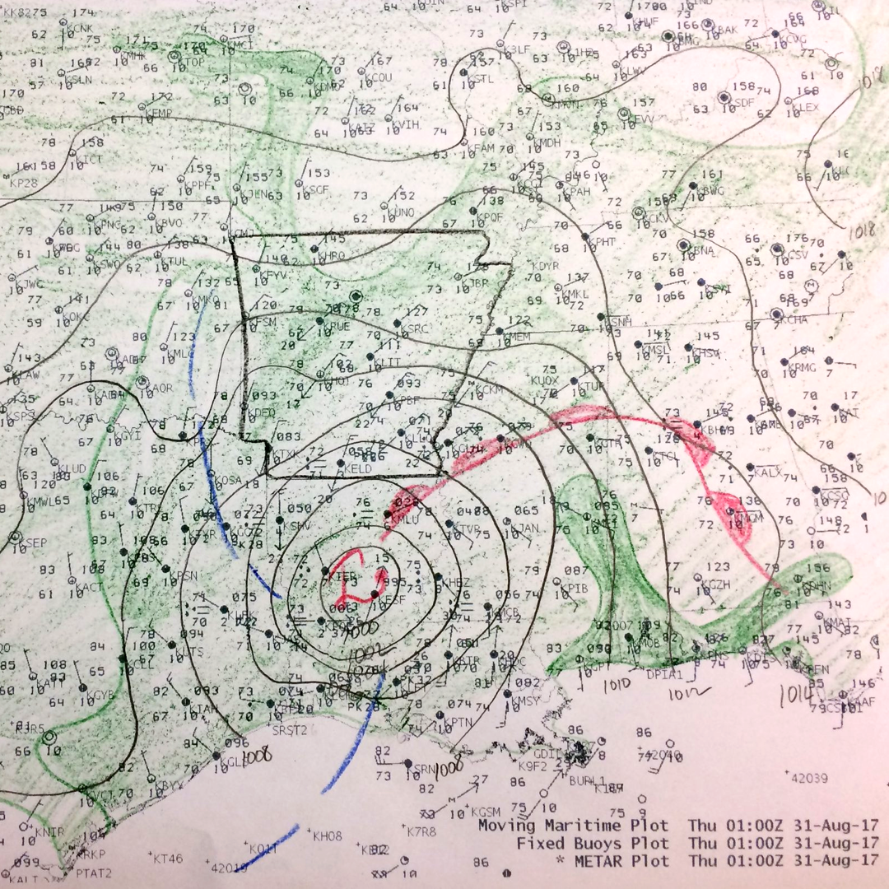
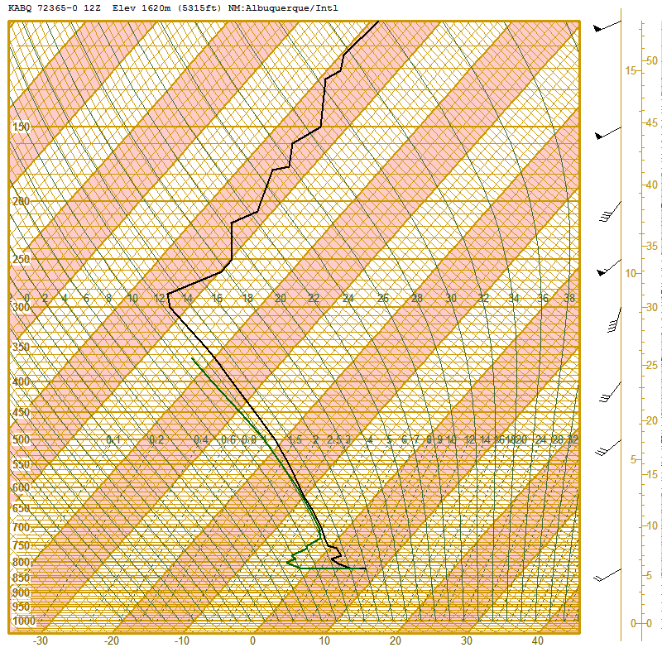
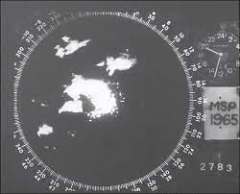
Blast from the Past!
Today’s goal:
Practice utilizing meteorological concepts learned so far to produce a 13 Z and subsequent Severe Weather Watch(es) (if needed)
Secondary Goal:
Get additional practice:
creating an outlook
hand analysis
writing discussions before the final!
Keep in mind:
During a real-time weather watch, you’ll have to filter through and analyze a LOT of information to come to the right conclusion - today will try to simulate that.

Slide 2
Blast from the Past!
How today will work:
Create a 13Z Outlook (20 minutes):
  Analyze 12Z Data
  Draw an outlook
Monitor Hourly Trends
  Complete hourly analyses (5 min each)
Update our outlook at 1630 (10 minutes)
Issue a Watch (if needed)
  Determine when to issue (group)
  Determine what type (group)
Outlook/Watch Draw Tool: wxwatcher.us/map/outlook/
Remember!
A watch should have 1-2 hours of lead time before the first report.

Slide 3
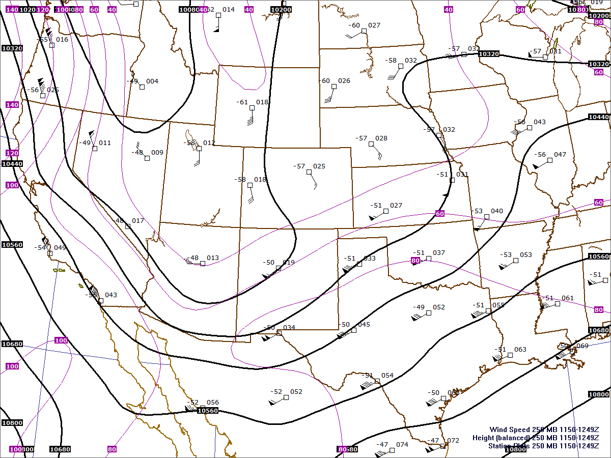
250 mb

Slide 4
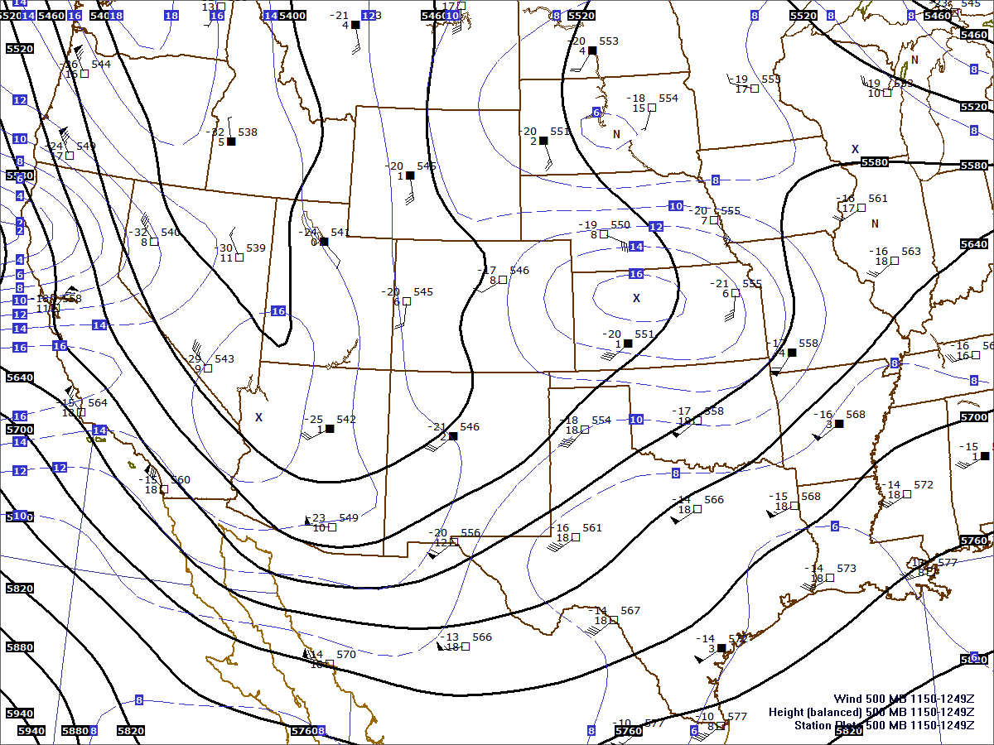
500 mb

Slide 5
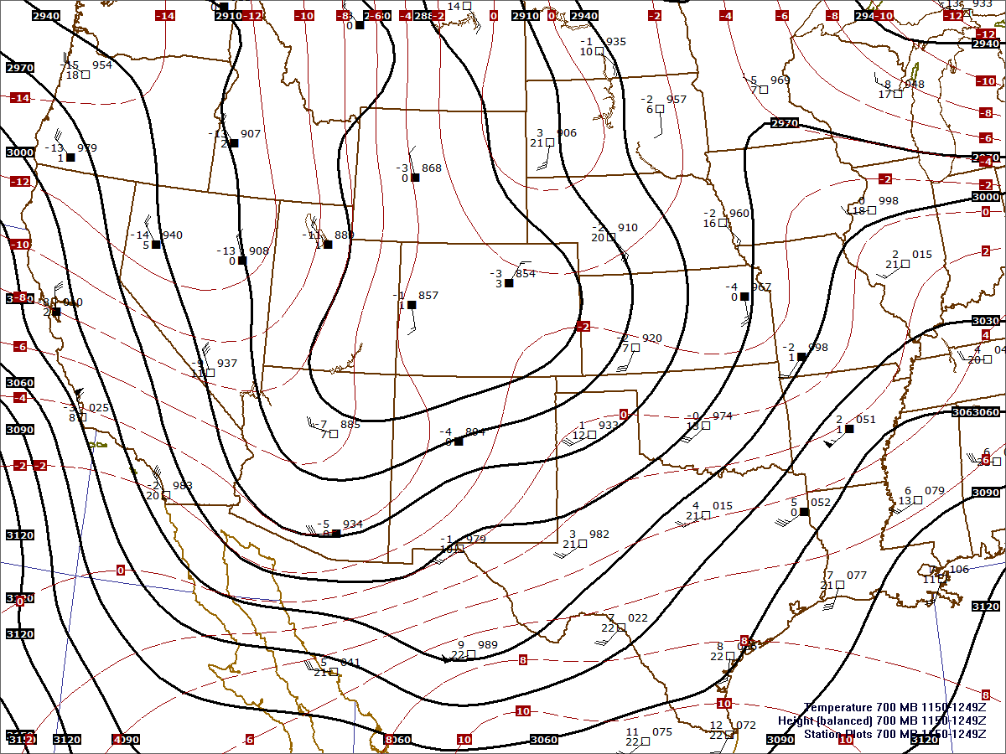
700 mb

Slide 6
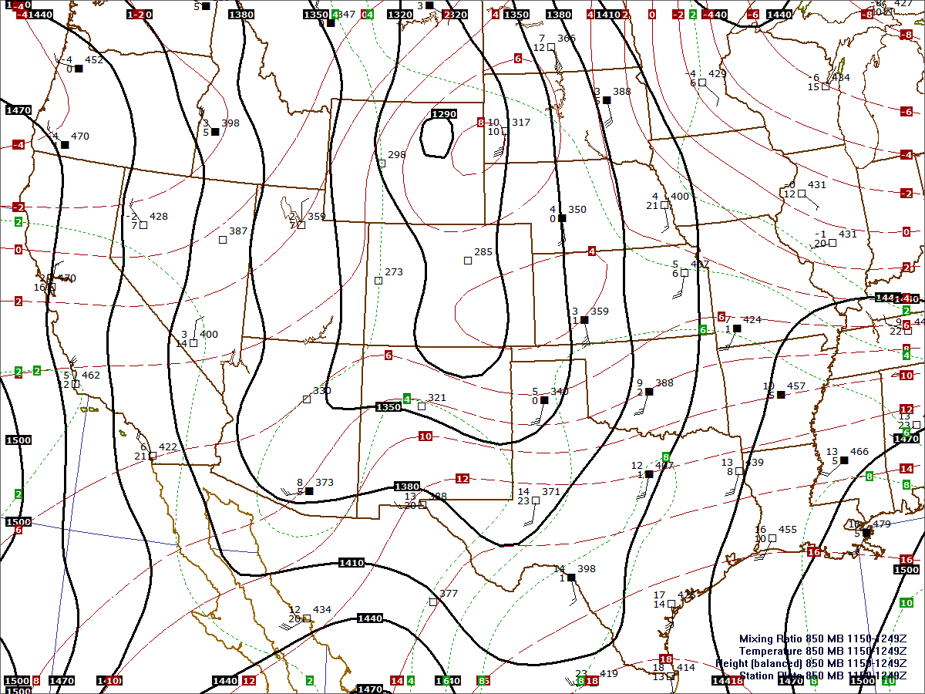
850 mb

Slide 7
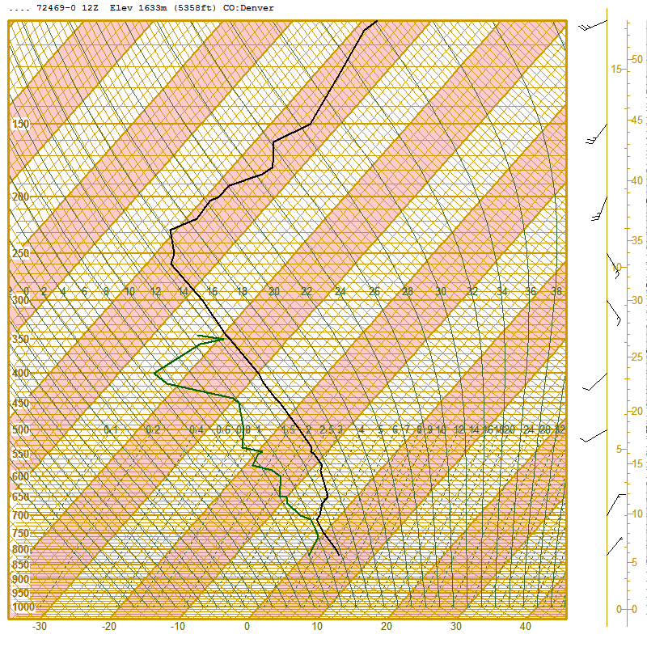
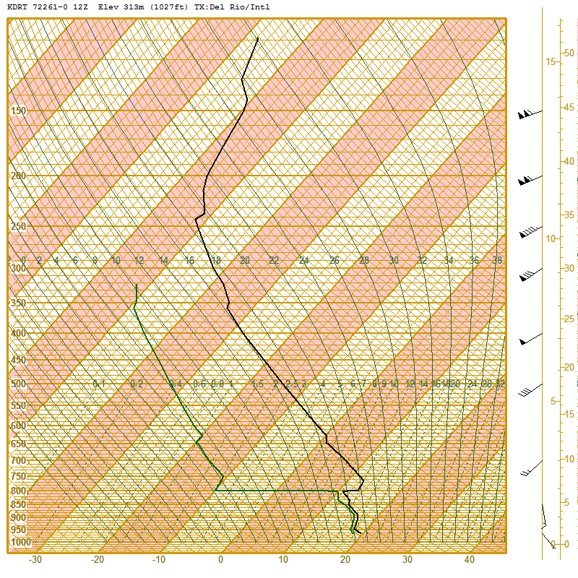
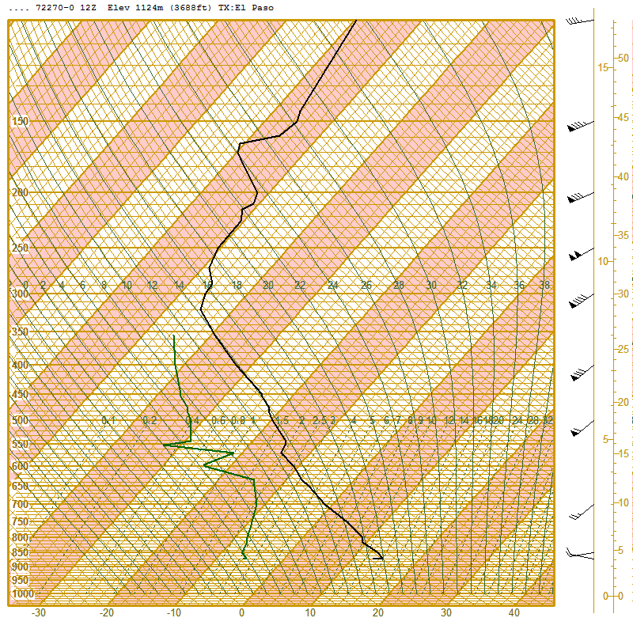
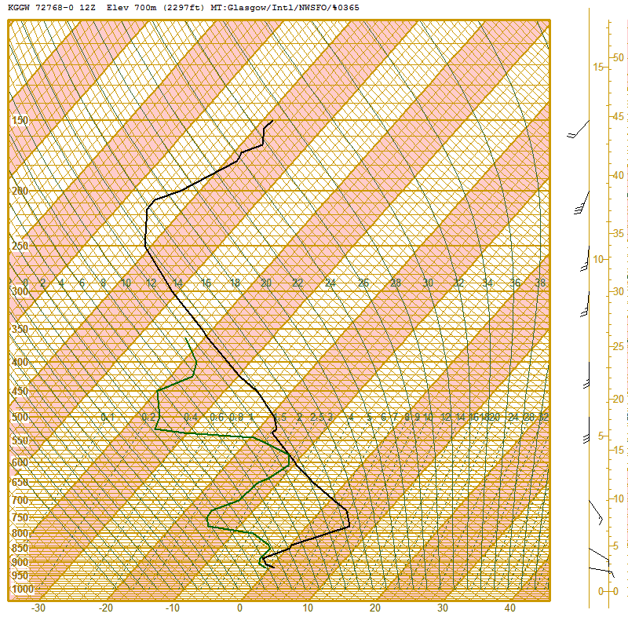
12 Z Glasgow, MT

Slide 8
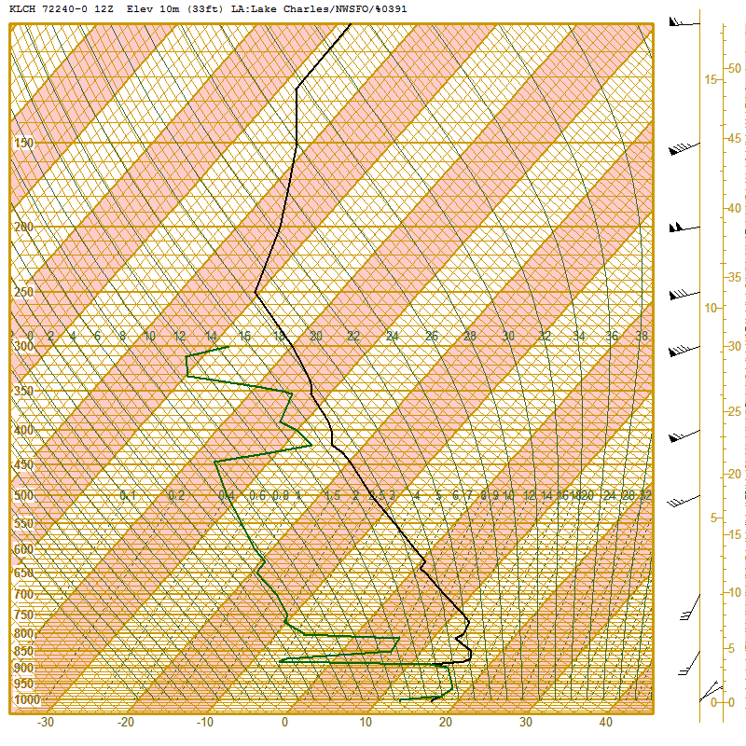
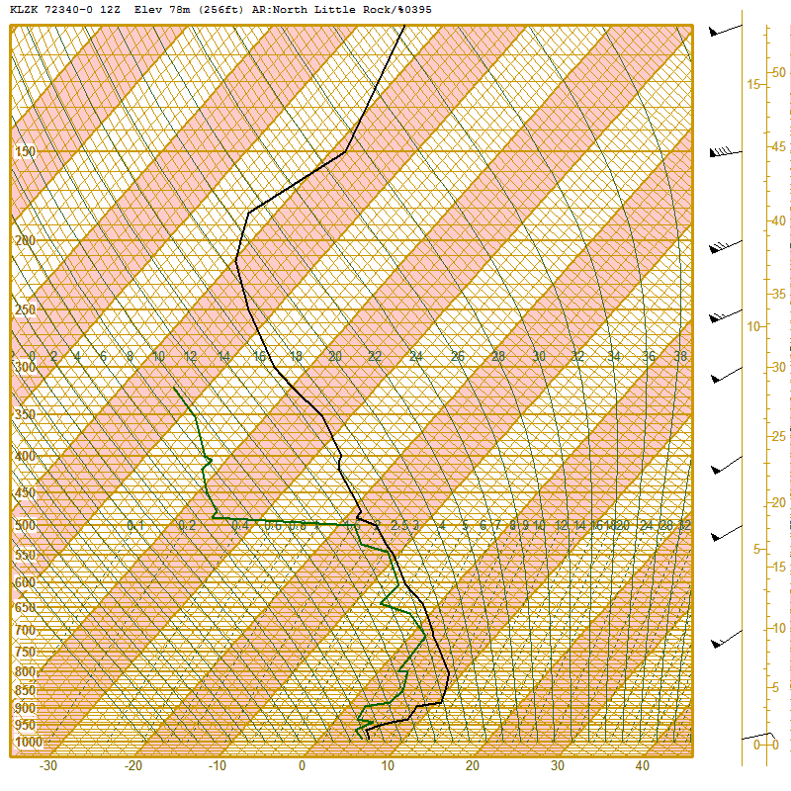
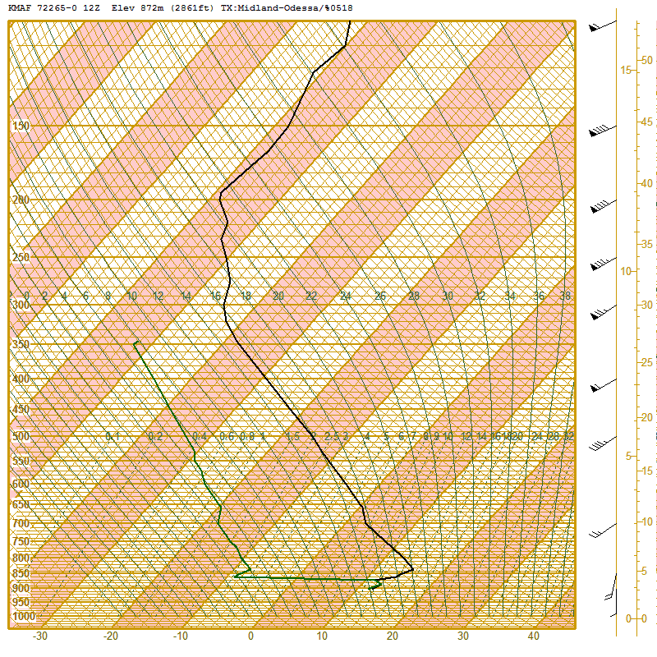
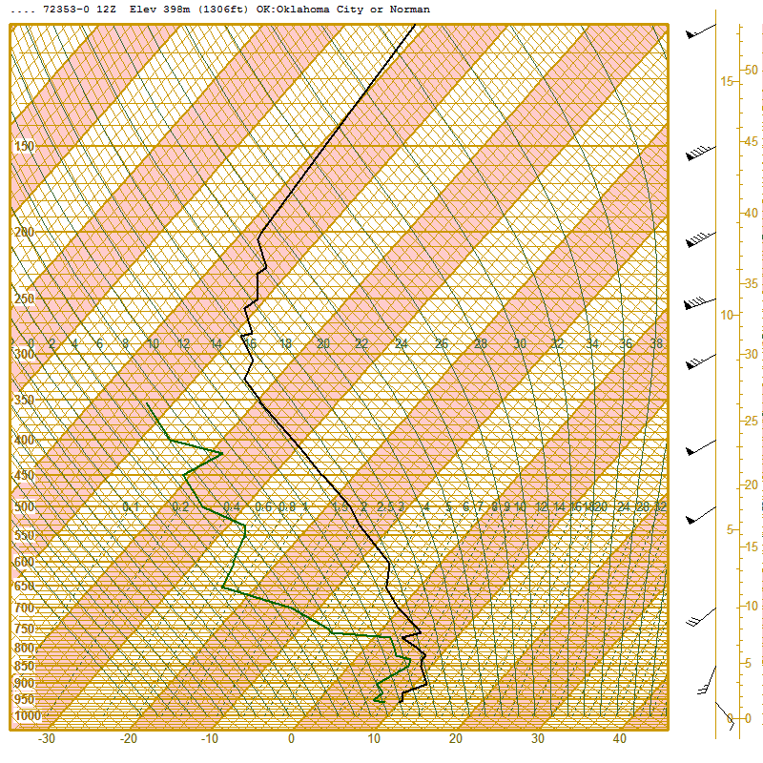
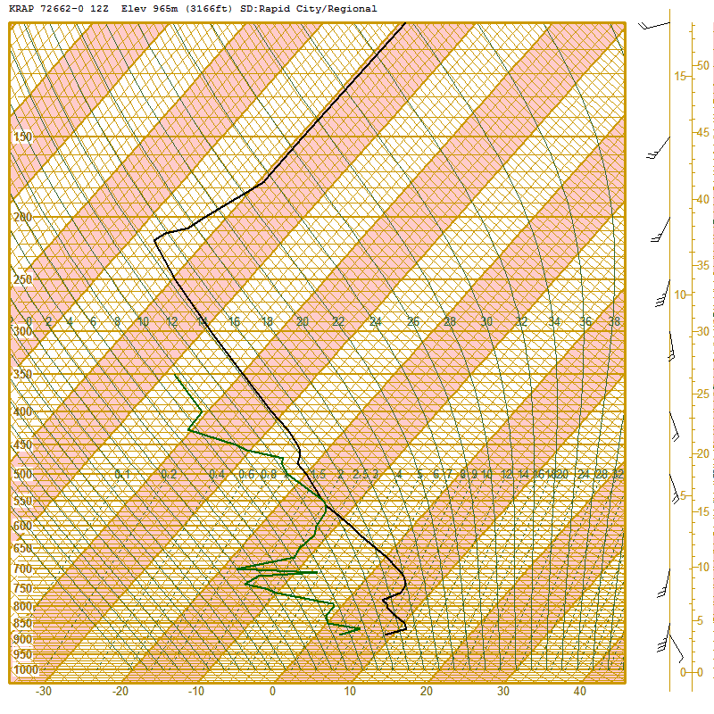
12 Z Rapid City, SD

Slide 9
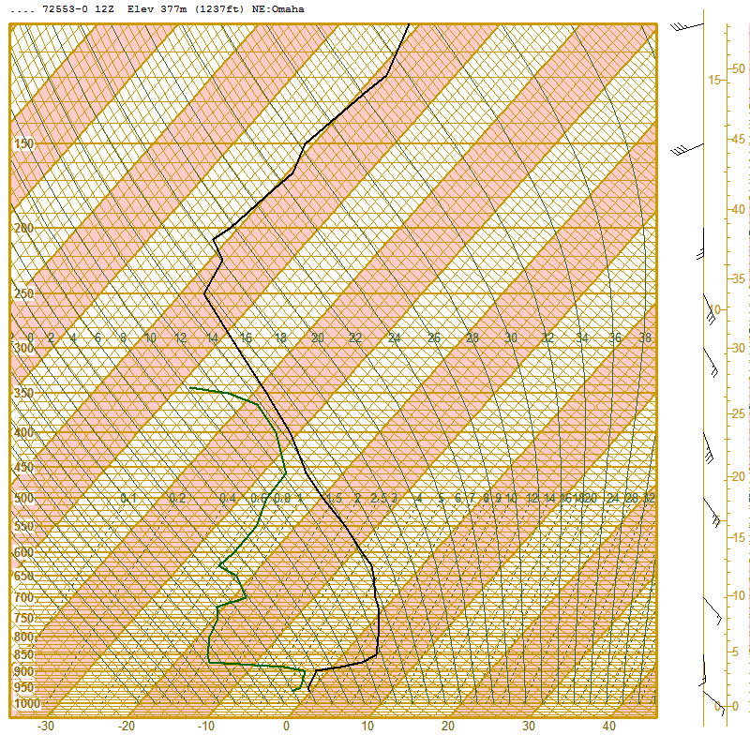
12 Z Omaha, NE

Slide 10
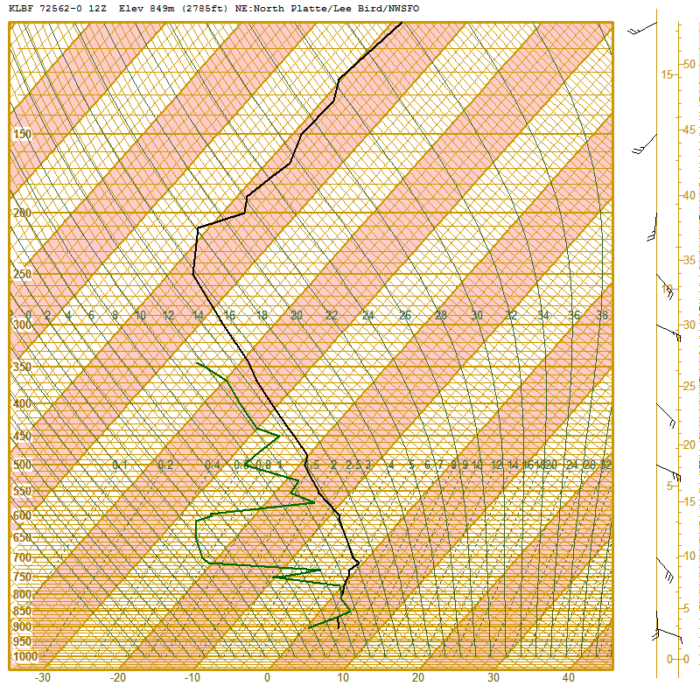
12 Z North Platte, NE

Slide 11
12 Z Denver, CO

Slide 12
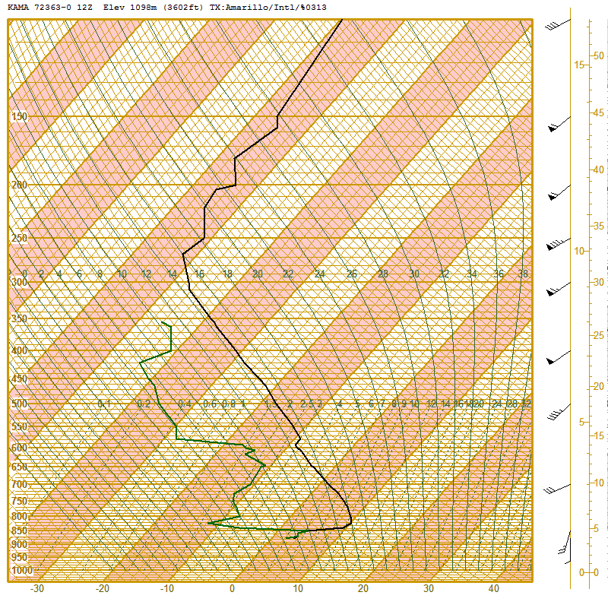
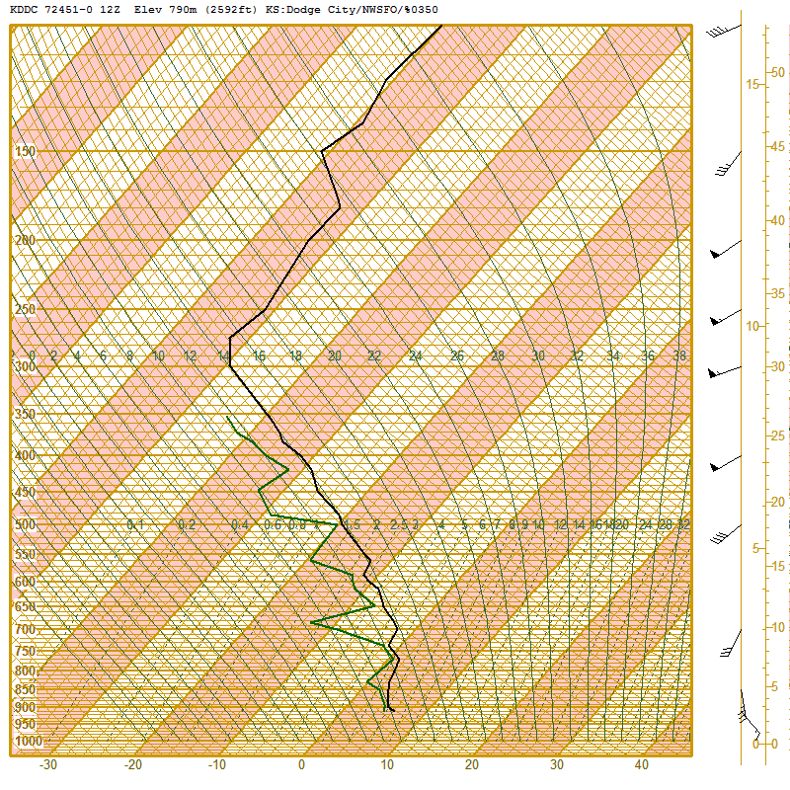
12 Z Dodge City, KS

Slide 13
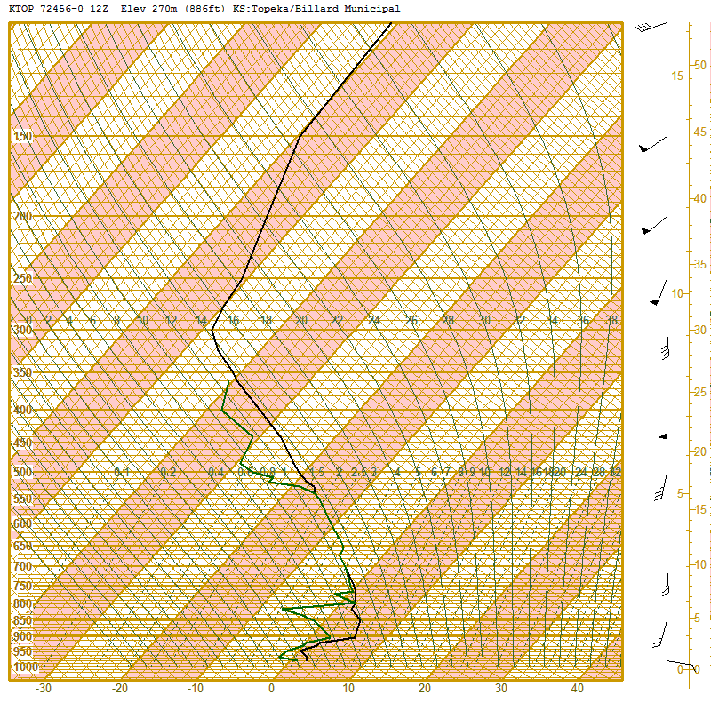
12 Z Topeka, KS

Slide 14
12 Z Albuquerque, NM

Slide 15
12 Z Amarillo, TX

Slide 16
12 Z Norman, OK

Slide 17
12 Z Little Rock, AR

Slide 18
12 Z Lake Charles, LA

Slide 19
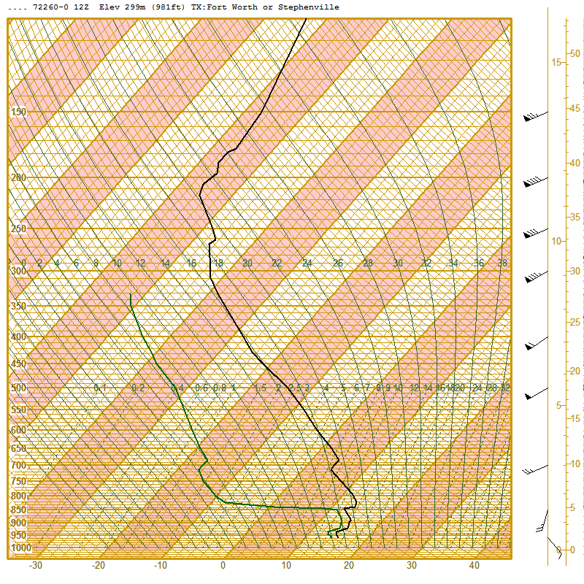
12 Z Fort Worth, TX

Slide 20
12 Z Del Rio, TX

Slide 21
12 Z Midland, TX

Slide 22
12 Z El Paso, TX

Slide 23
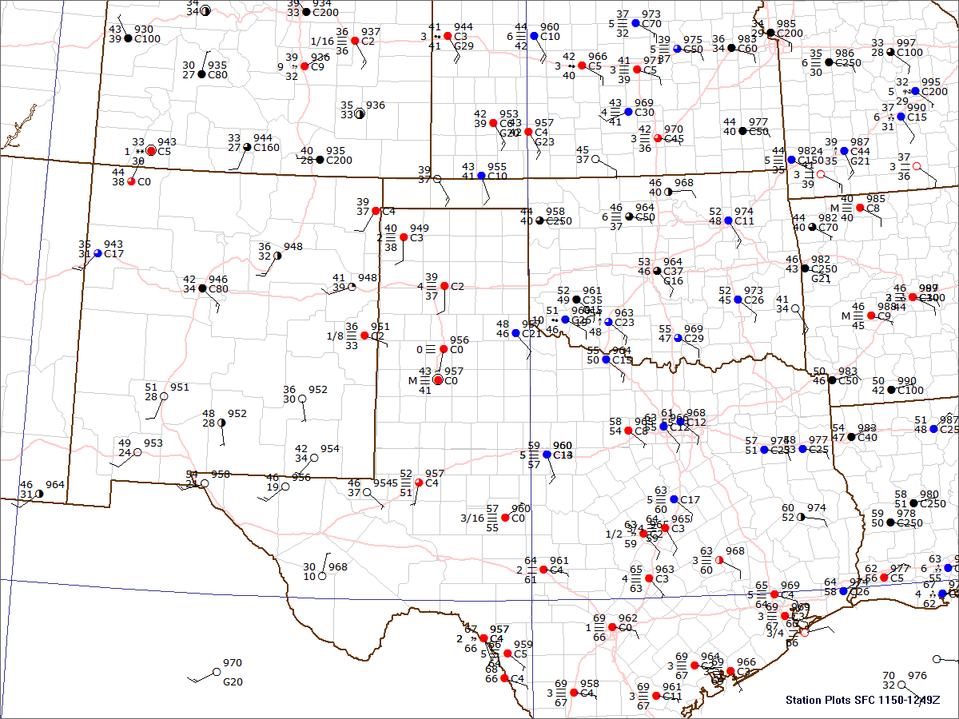
12:00 UTC

Slide 24
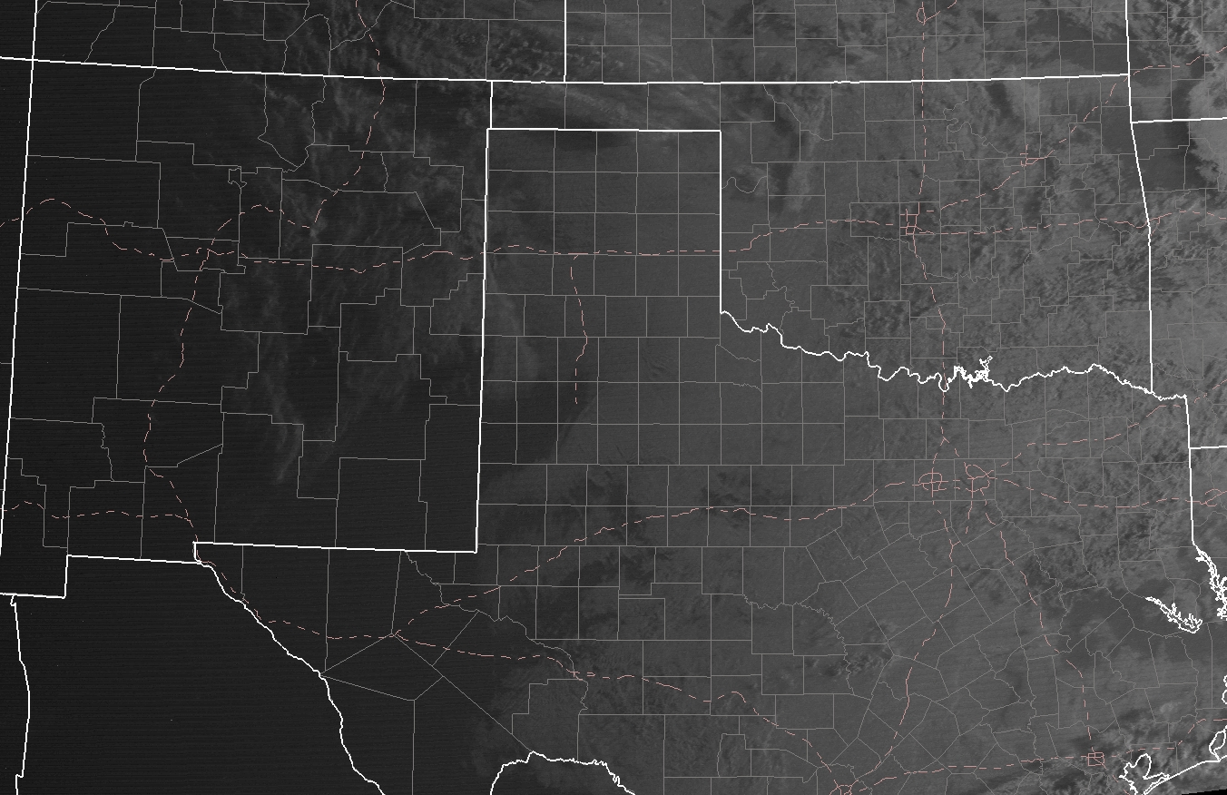
12:45 UTC

Slide 25
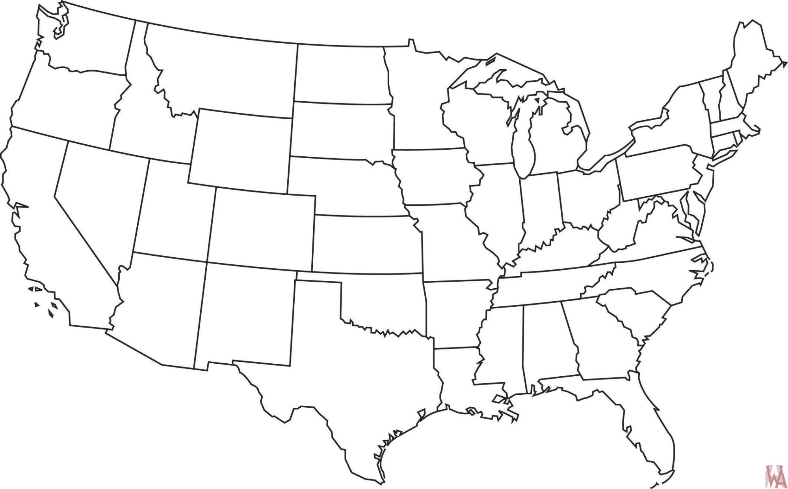
Initial Thoughts?
Where will there be strong upper-level lift?
Will the 850 mb low deepen? Move?
Where are the best lapse rates?
Where is the best low-level moisture?
Where is favorable instability likely?
Where do you expect the strongest deep-layer shear?
Where do you expect the best low-level shear?

Slide 26
HAND ANALYSIS TIME!
Let’s take the next 10-15 to do a rough hand analysis
Priorities:
Boundaries
Moisture
Temperature
Surface Pressure

Slide 27
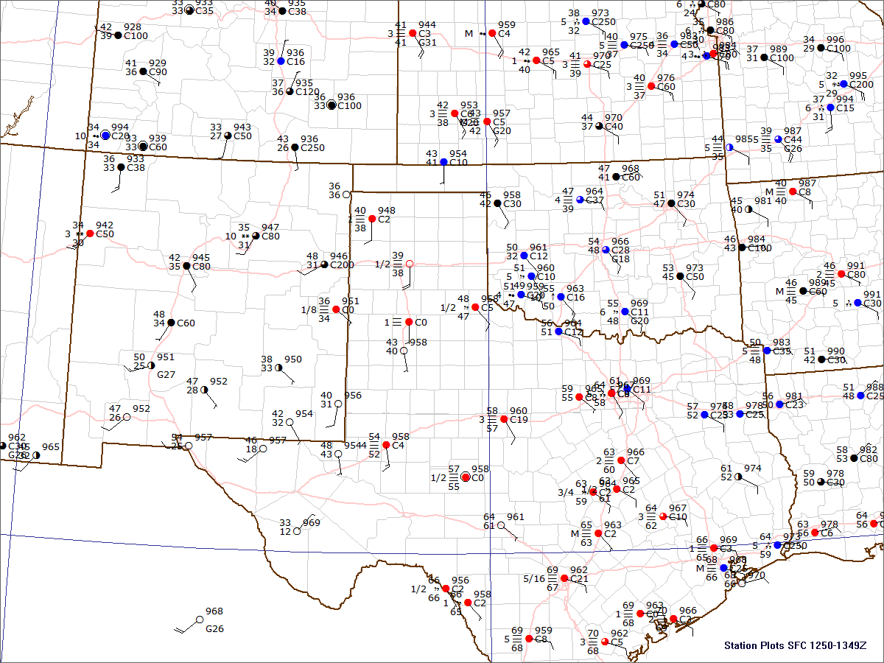
13:00 UTC

Slide 28
Create a 13Z Outlook
What is the areal coverage of the threat?
Are there more than one areas
of concern?
What is the most likely storm mode?
What is the most likely hazard?
What will the highest category be?
How confident are we?
https://armchairforecaster.com/pages/outwatch/

Slide 29
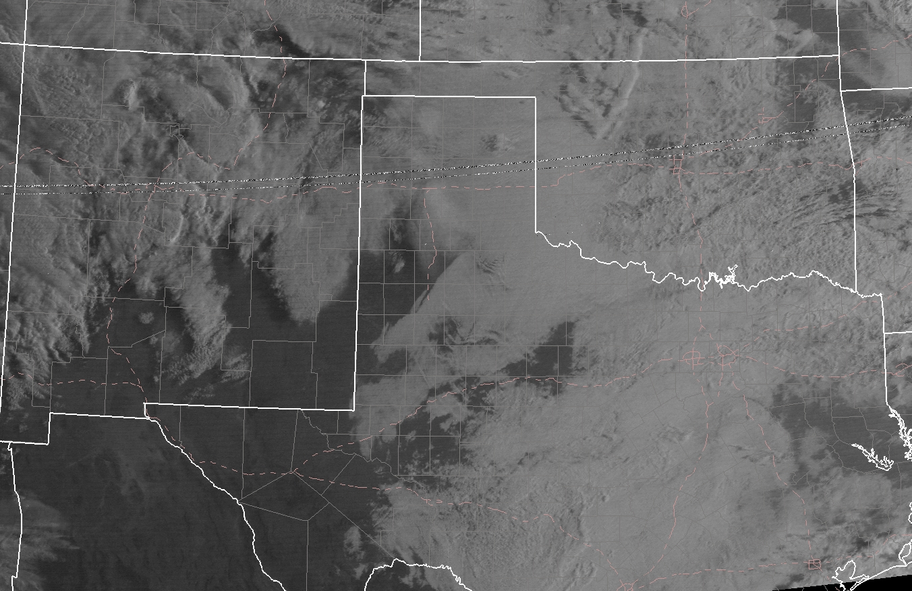
13:45 UTC

Slide 30
14 Z Update
Watch Consideration:
When to start?
When to end?
What Type?
If it’s time, let’s write a
mesoscale discussion!

Slide 31
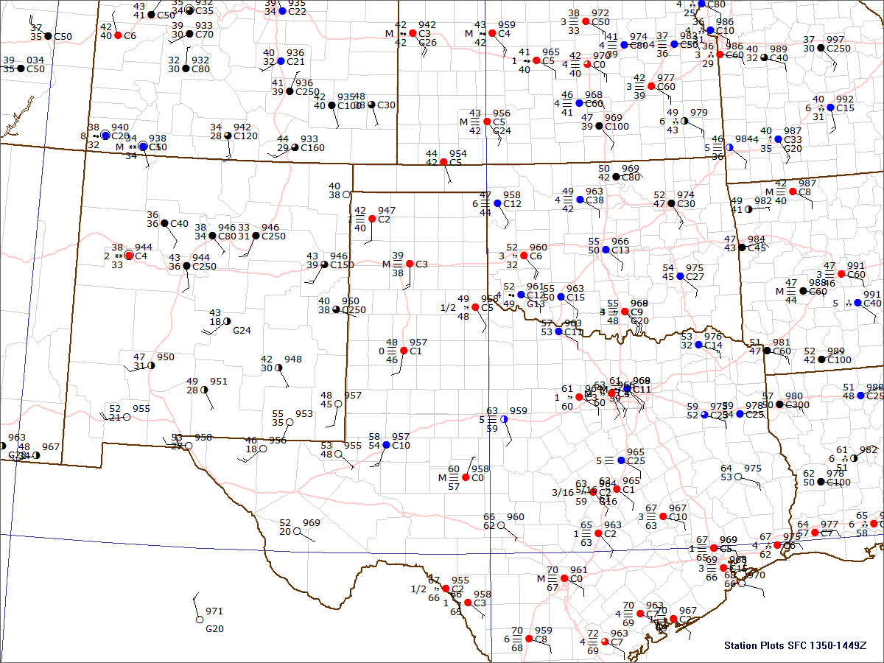
14:00 UTC

Slide 32
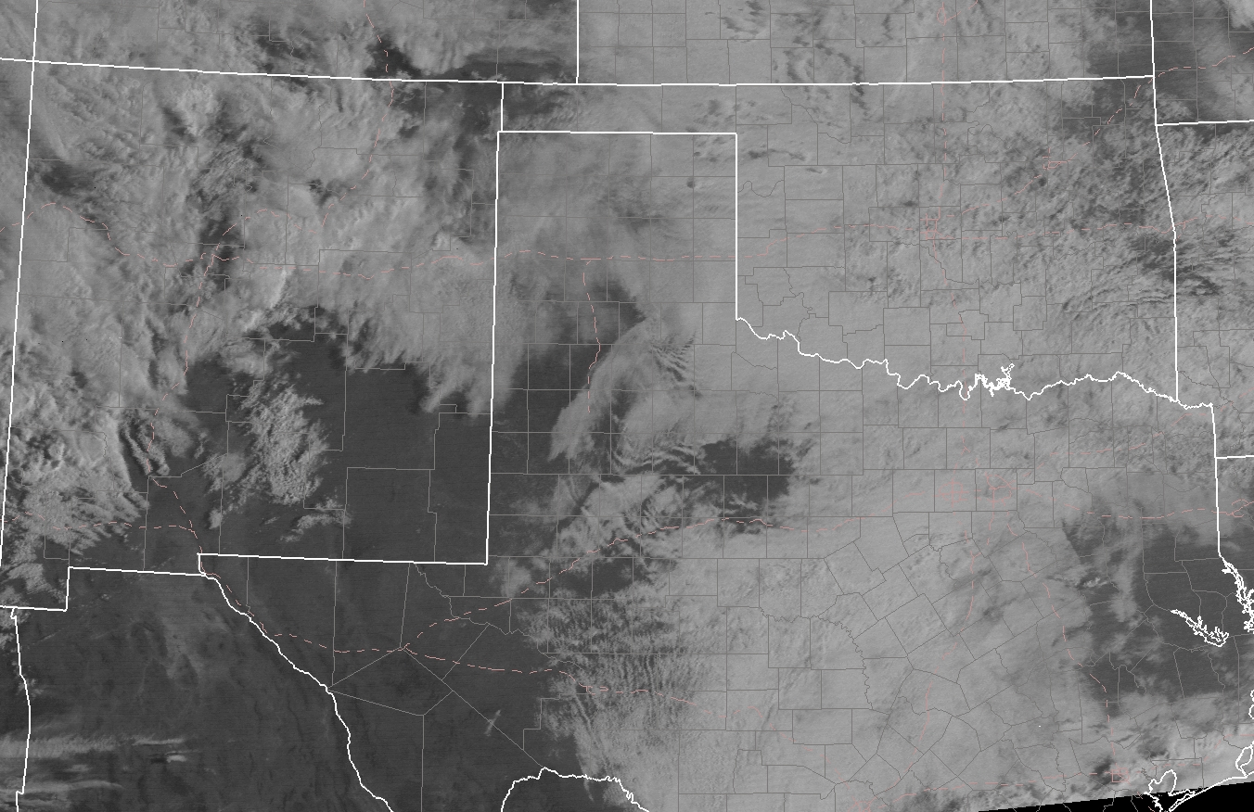
14:45 UTC

Slide 33
15 Z Update
Watch Consideration:
When to start?
When to end?
What Type?
If it’s time, let’s write a
mesoscale discussion!

Slide 34
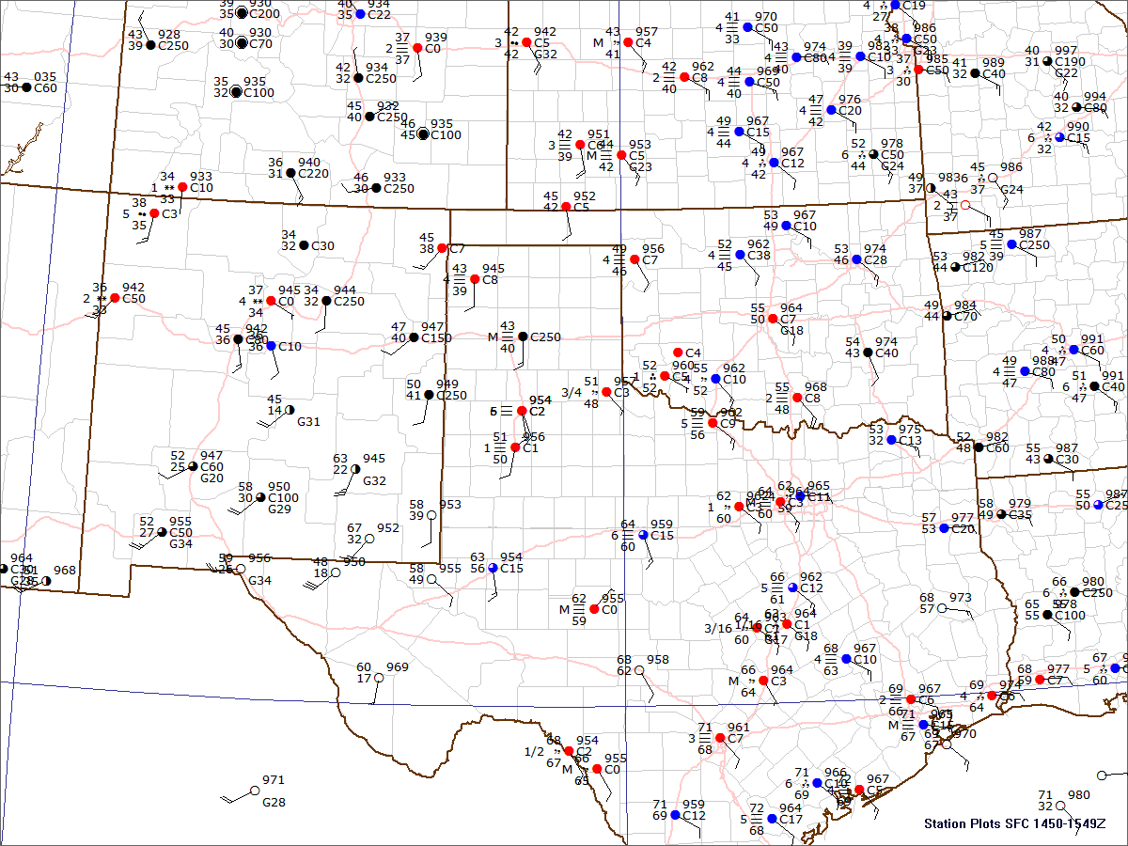
15:00 UTC

Slide 35
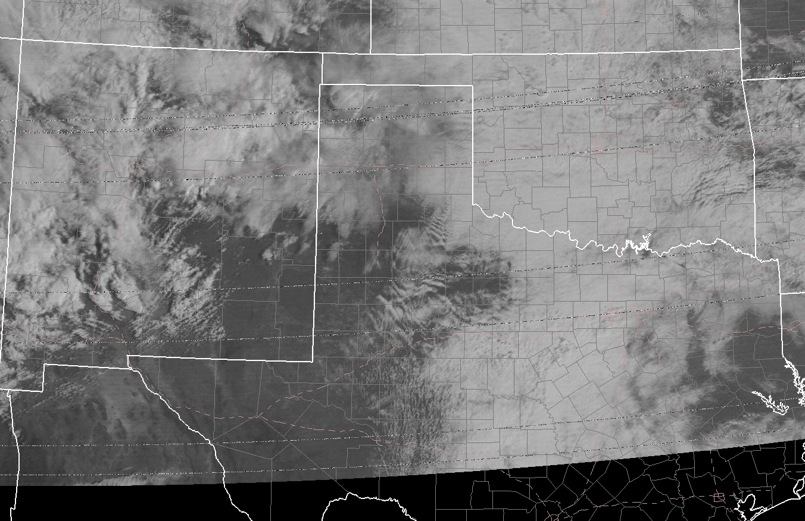
15:45 UTC

Slide 36
16 Z Update
Watch Consideration:
When to start?
When to end?
What Type?
If it’s time, let’s write a
mesoscale discussion!

Slide 37
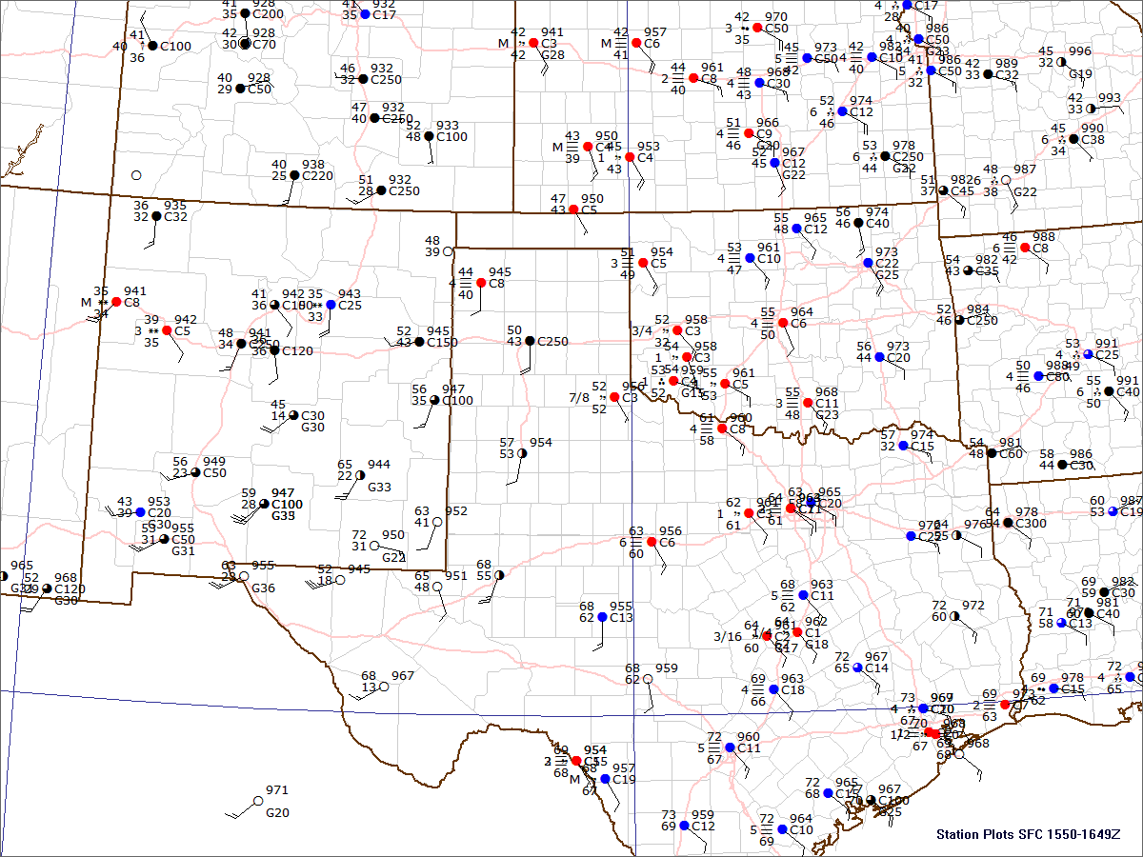
16:00 UTC

Slide 38
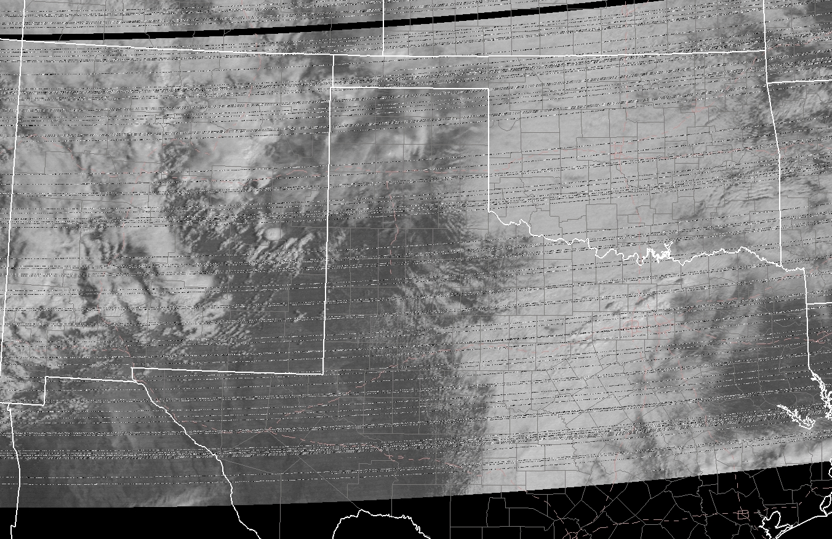
16:45 UTC

Slide 39
1630 Outlook Update
Based off the recent trends, do we need to adjust the outlook?

Slide 40
17 Z Update
Watch Consideration:
When to start?
When to end?
What Type?
If it’s time, let’s write a
mesoscale discussion!

Slide 41
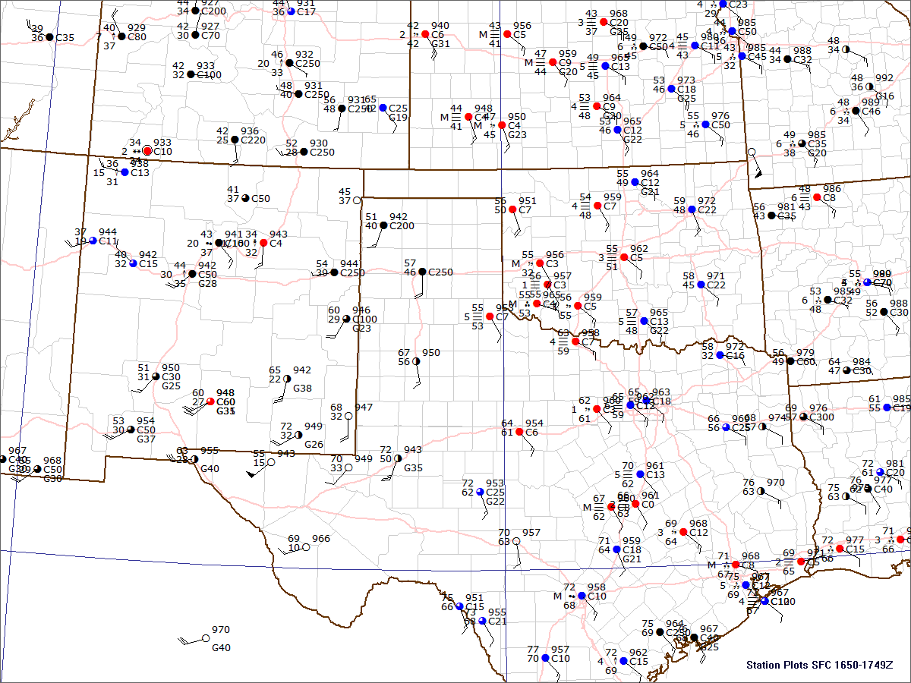
17:00 UTC

Slide 42
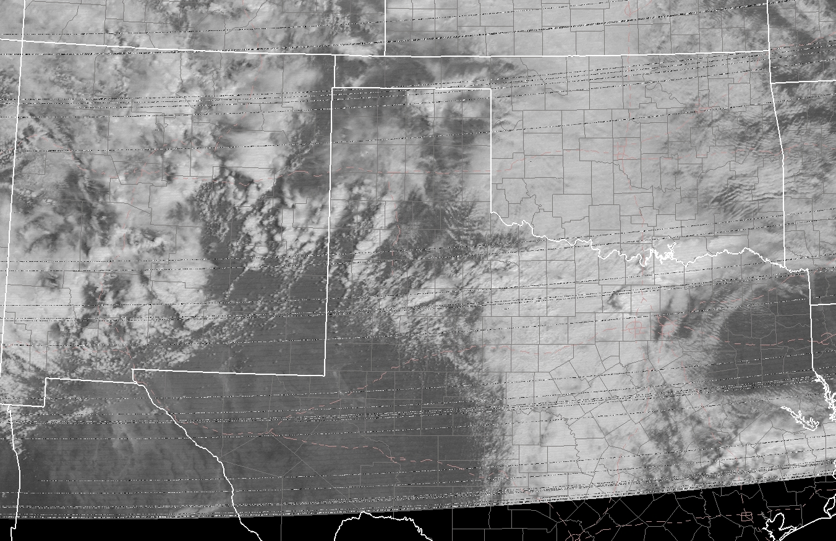
17:45 UTC

Slide 43
18 Z Update
Watch Consideration:
When to start?
When to end?
What Type?
If it’s time, let’s write a
mesoscale discussion!

Slide 44
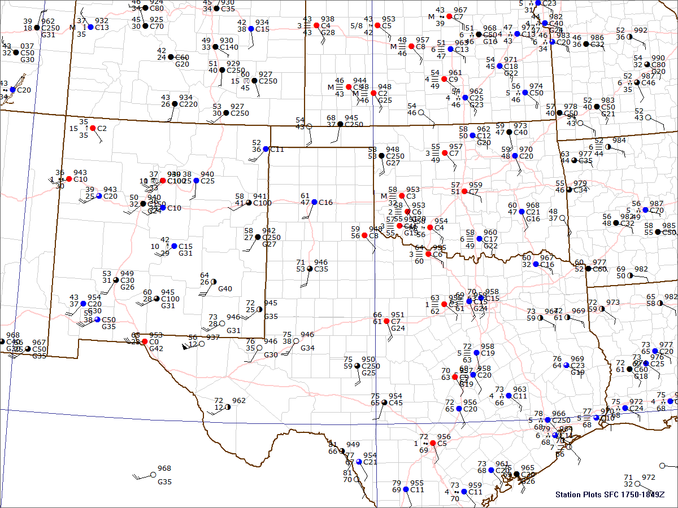
18:00 UTC

Slide 45
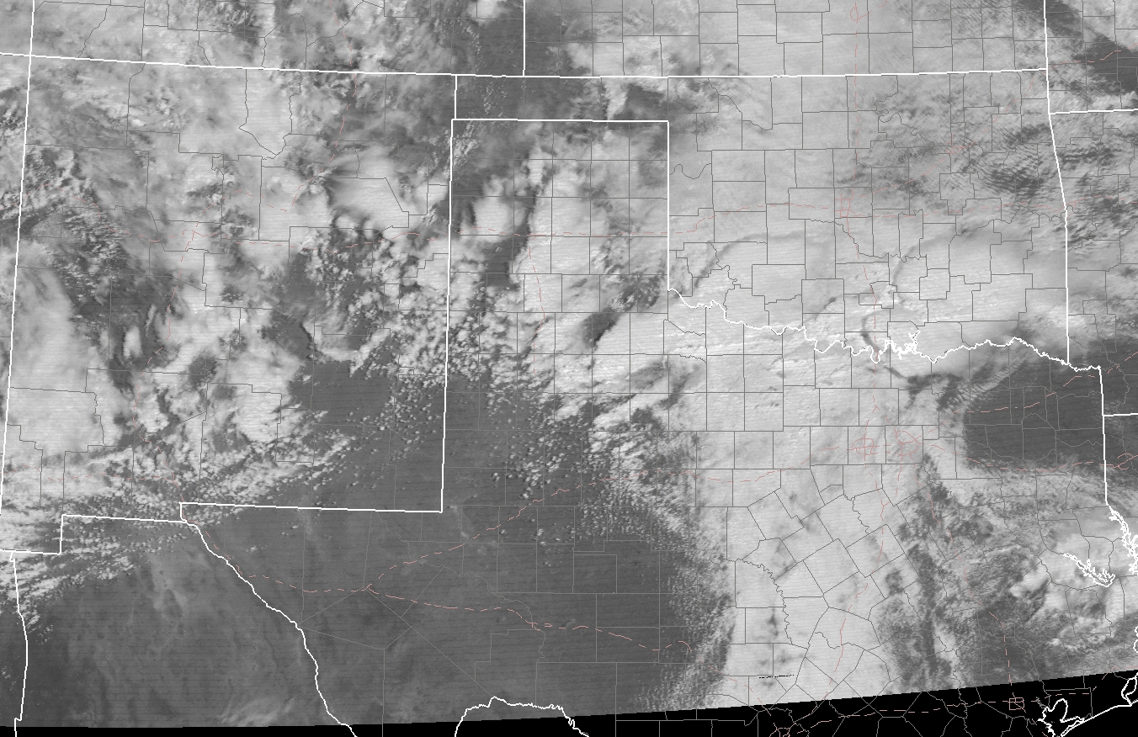
18:45 UTC

Slide 46
19 Z Update
Watch Consideration:
When to start?
When to end?
What Type?
If it’s time, let’s write a
mesoscale discussion!

Slide 47
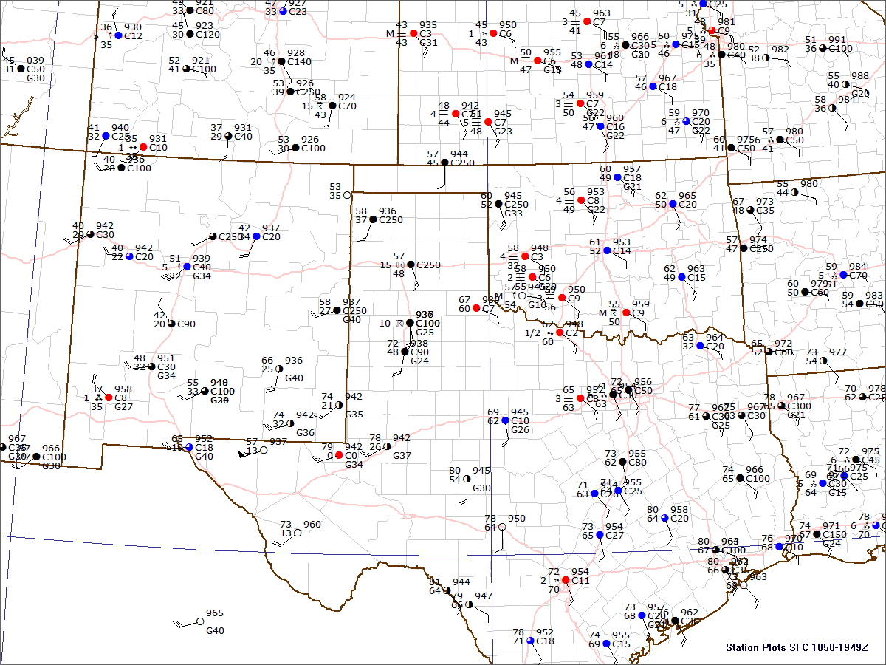
19:00 UTC

Slide 48
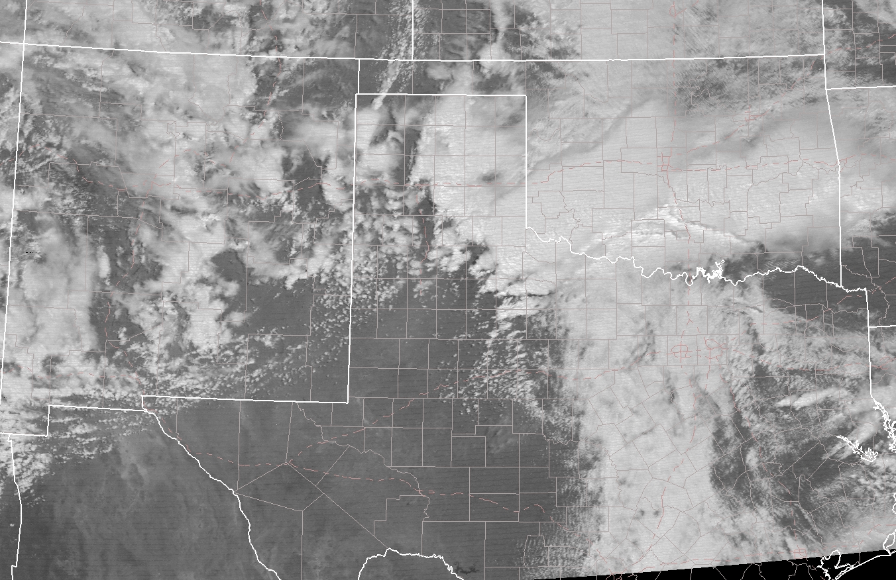
19:45 UTC

Slide 49
1938 UTC (~10 min before image)
Plainview, TX Tornado
Rated F0
1908 UTC (~35 min before image)
Crosby, TX Tornado
Rated F0
19:45 UTC

Slide 50
20 Z Update
Watch Consideration:
When to start?
When to end?
What Type?
If it’s time, let’s write a
mesoscale discussion!

Slide 51
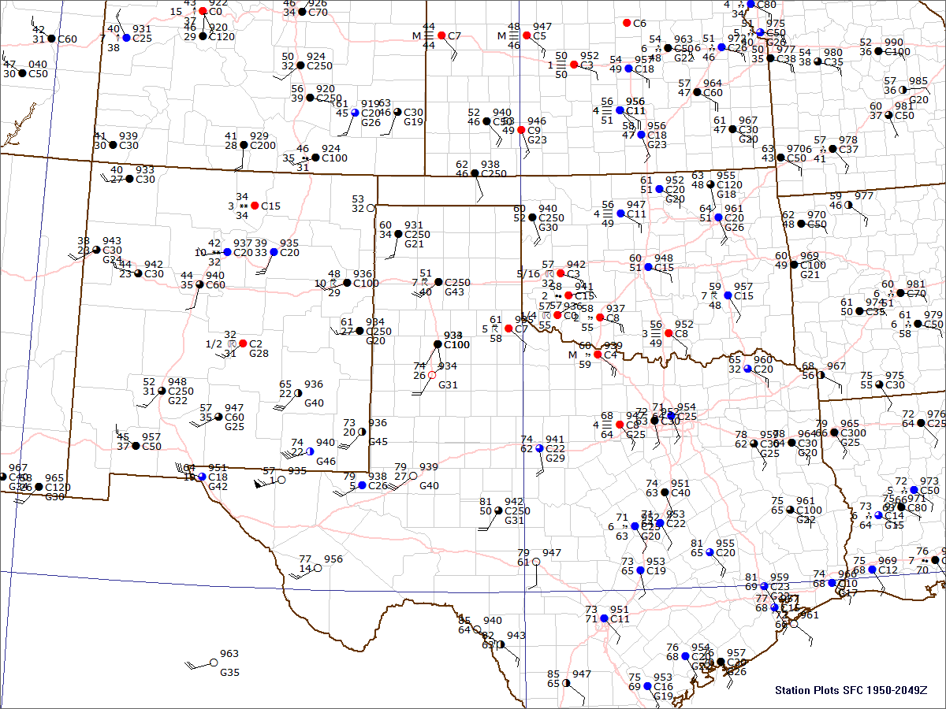
20:00 UTC

Slide 52
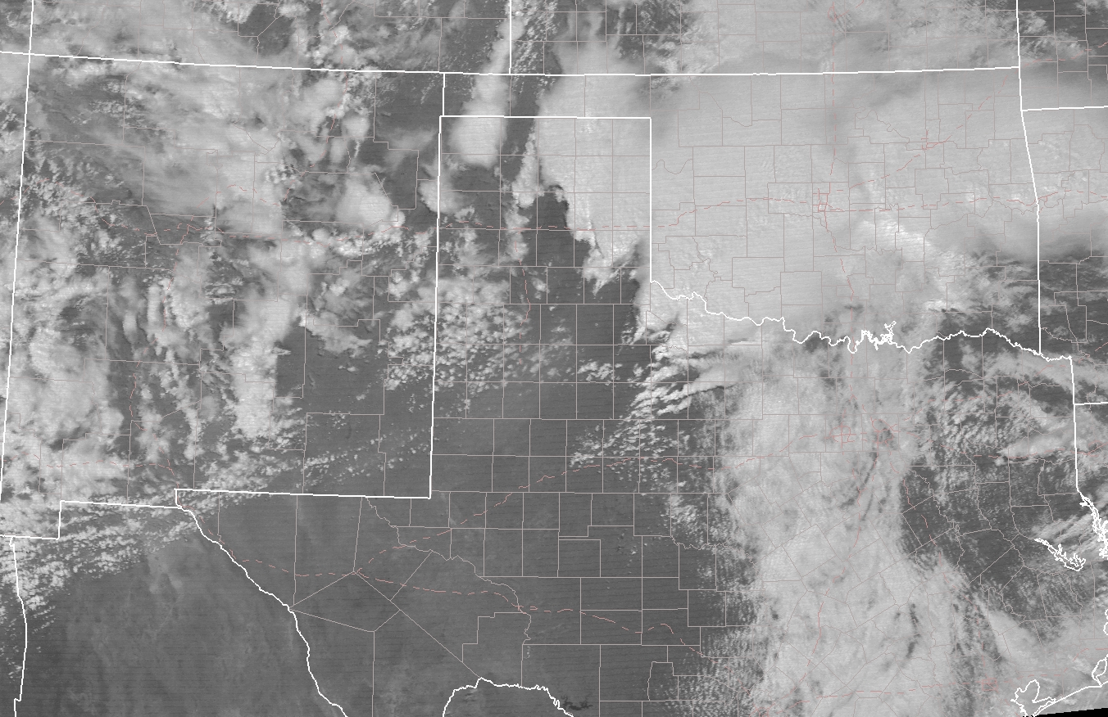
20:45 UTC

Slide 53
21:20 UTC (~35 min after image)
Vernon, TX Tornado
Rated F4
11 Fatalities
20:45 UTC

Slide 54
21 Z Update
Watch Consideration:
When to start?
When to end?
What Type?
If it’s time, let’s write a
mesoscale discussion!

Slide 55
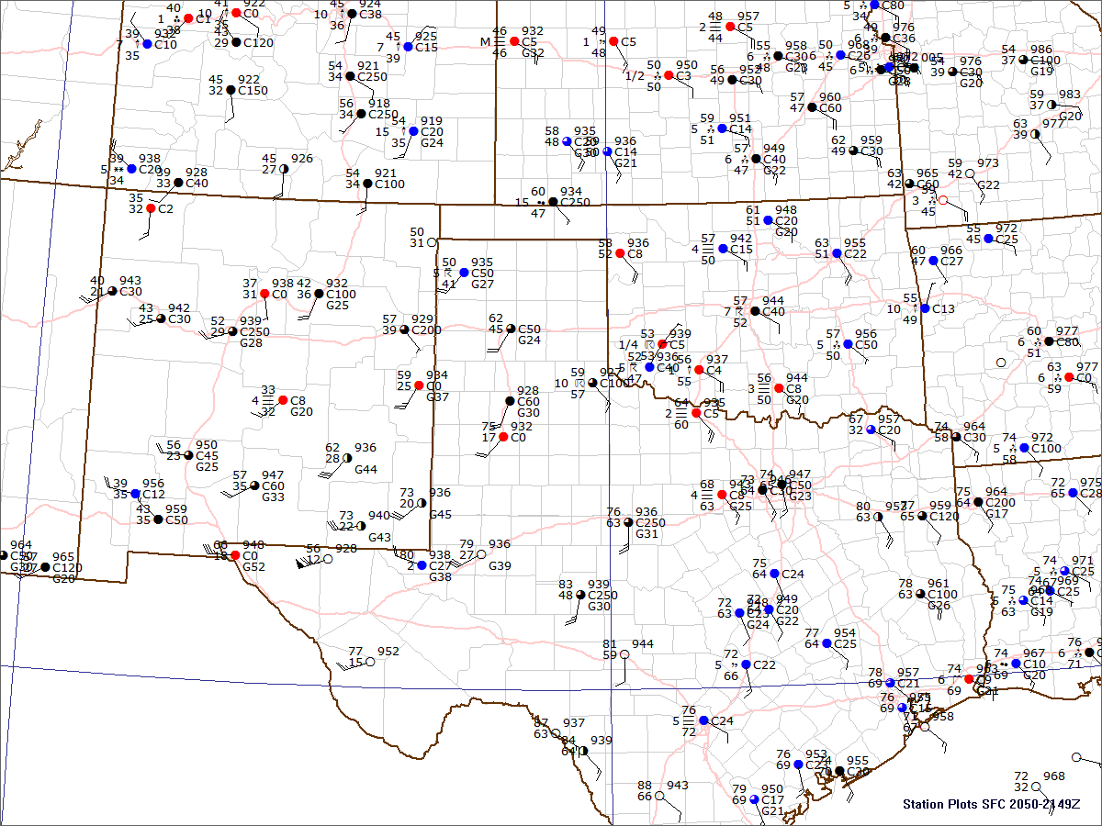
21:00 UTC

Slide 56
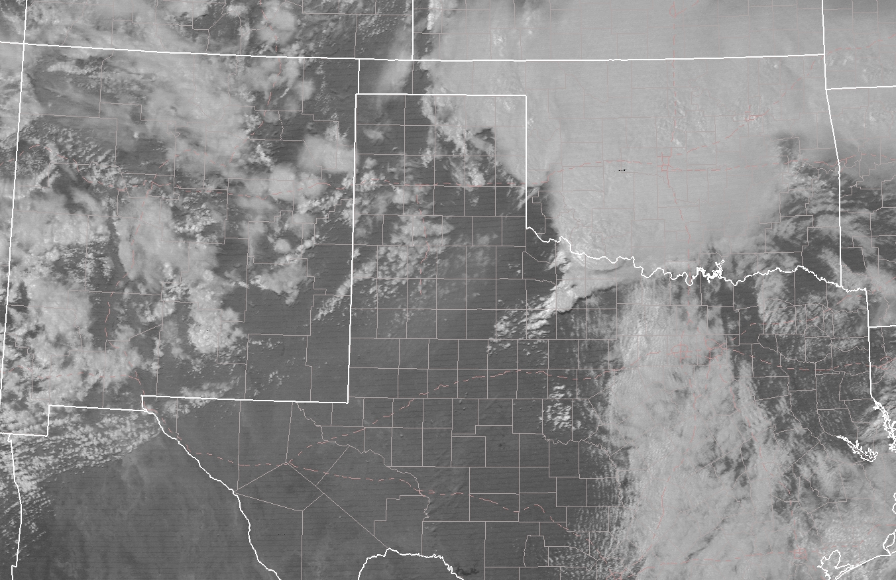
21:45 UTC

Slide 57
21:55 UTC (~10 min after image)
Harrold, TX - Marlow, OK Tornado
Rated F2
1 Fatality
21:45 UTC

Slide 58
22 Z Update
Watch Consideration:
When to start?
When to end?
What Type?
If it’s time, let’s write a
mesoscale discussion!

Slide 59
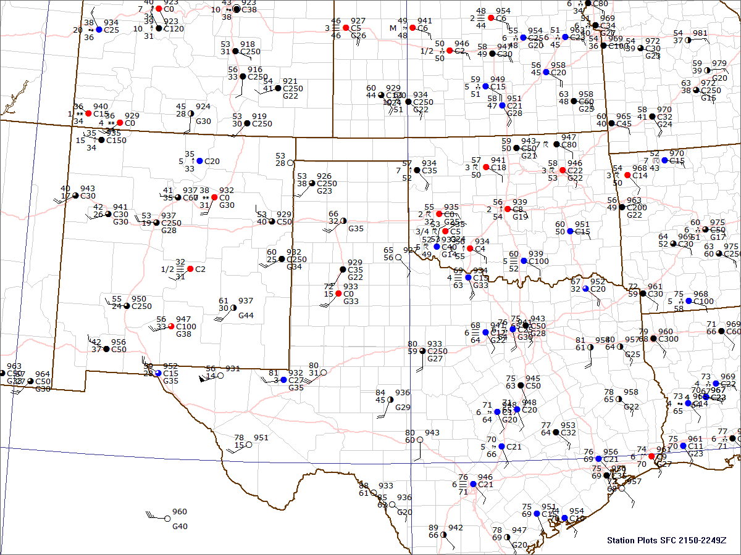
22:00 UTC

Slide 60
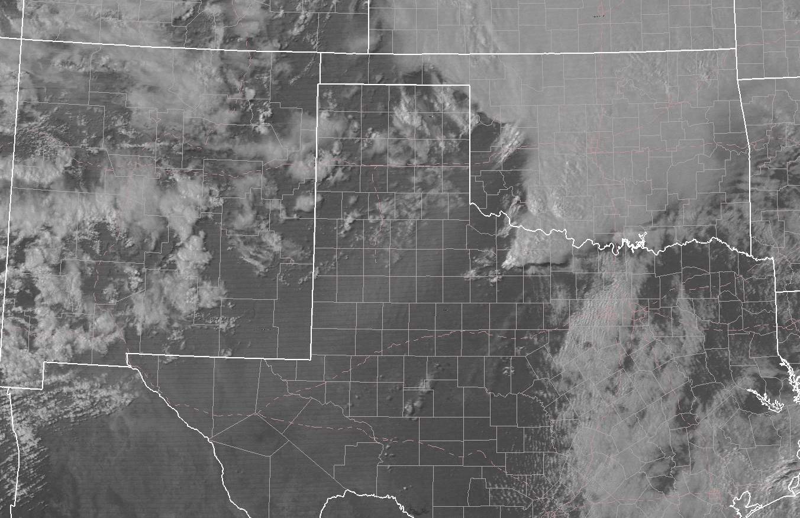
22:45 UTC

Slide 61
23:05 UTC (~20 min after image)
Lawton, OK Tornado
Rated F3
3 Fatalities
22:45 UTC

Slide 62
23 Z Update
Watch Consideration:
When to start?
When to end?
What Type?
If it’s time, let’s write a
mesoscale discussion!

Slide 63
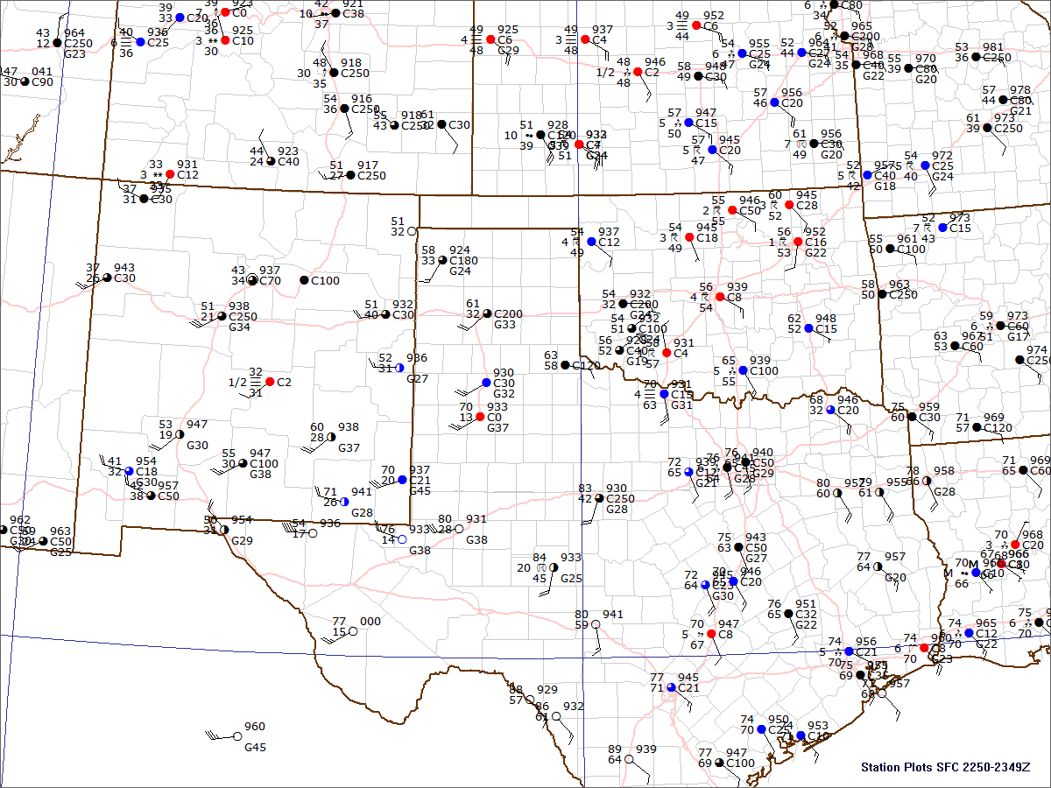
23:00 UTC

Slide 64
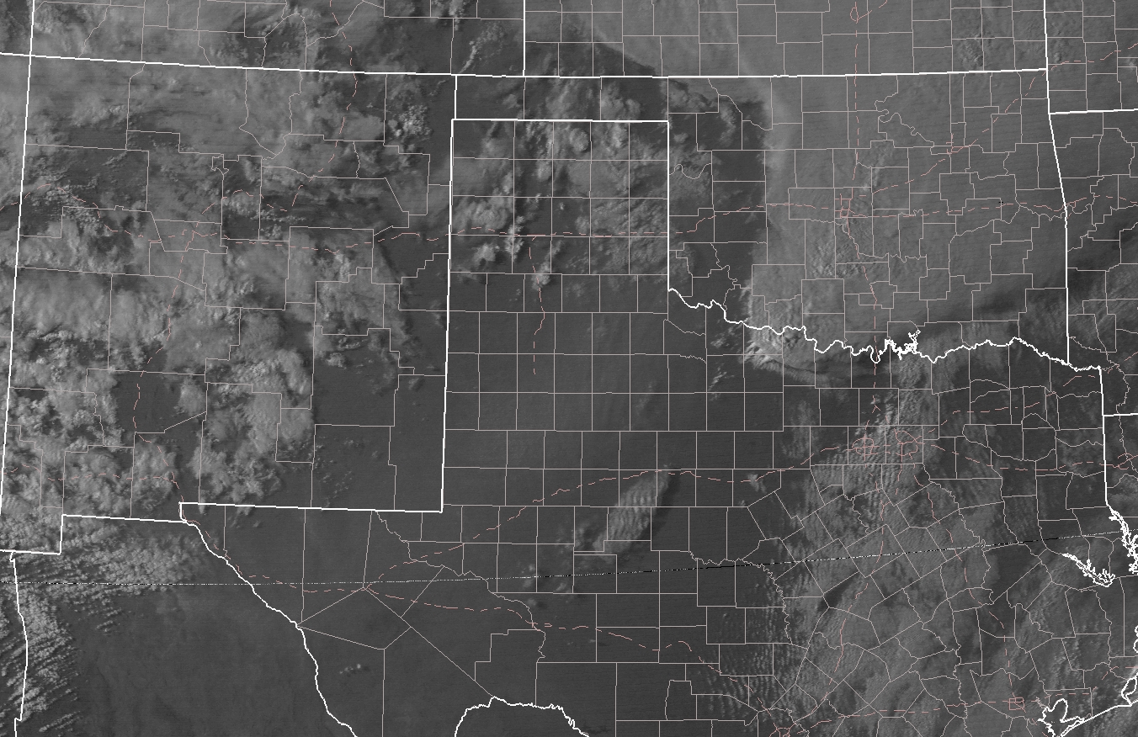
23:50 UTC (~5 min after image)
Wichita Falls, TX Tornado
Rated F4
42 Fatalities
23:45 UTC

Slide 65
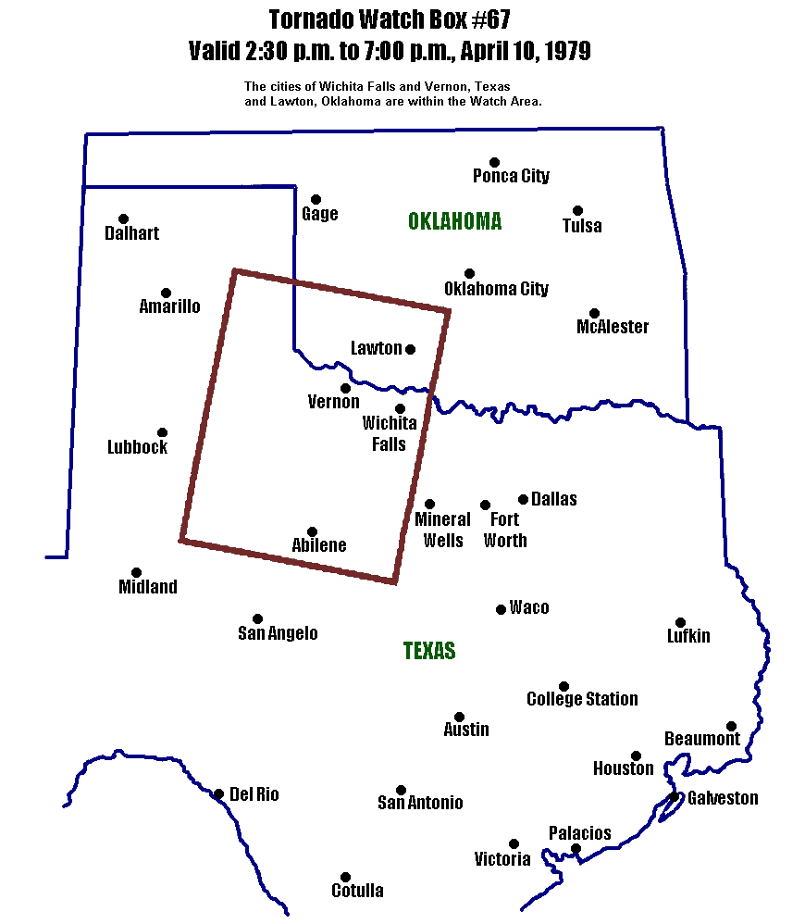
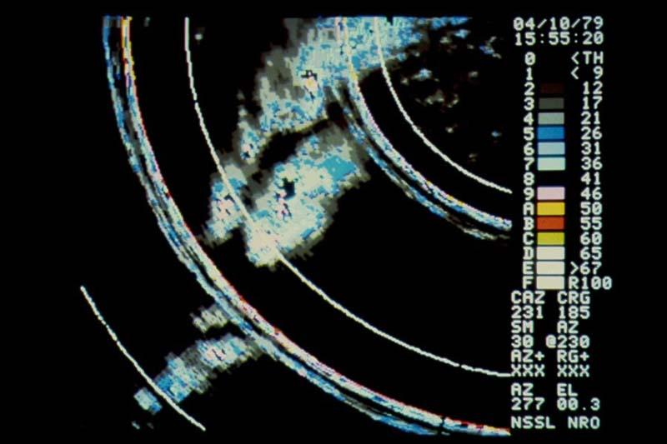
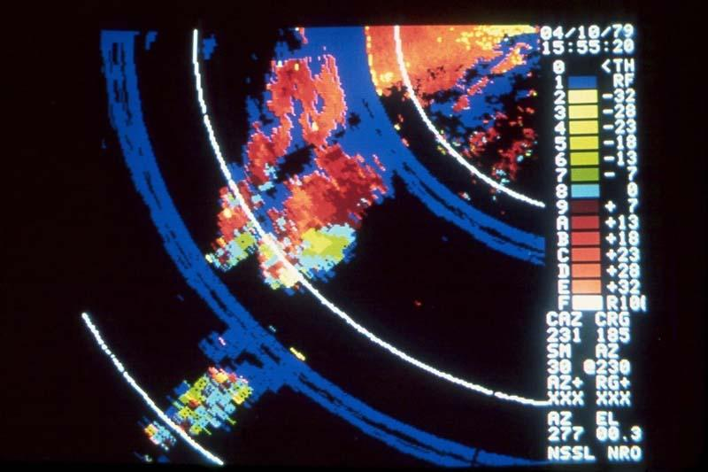

Terrible Tuesday!
April 10, 1979
Red River Valley Tornado Outbreak
59 Tornadoes
56 Fatalities

Slide 66




Slide 67


Slide 68


Slide 69

Terrible Tuesday Documentary:
Excellent review by WFO Norman:
https://www.weather.gov/oun/events-19790410

Slide 70
250 mb
75 knots
X
90 knots
X
X

Slide 71
500 mb
50 knots
75 knots
X
X
X

Slide 72
700 mb
WAA
CAA
X
X
X

Slide 73
850 mb
L
WAA
CAA
L

Slide 74
L
12:00 UTC

Slide 75
L
13:00 UTC

Slide 76
L
14:00 UTC

Slide 77
L
15:00 UTC

Slide 78
L
16:00 UTC

Slide 79
L
17:00 UTC

Slide 80
L
18:00 UTC

Slide 81
L
19:00 UTC

Slide 82
L
20:00 UTC

Slide 83
L
21:00 UTC

Slide 84
L
22:00 UTC

Slide 85
23:00 UTC

